Slide 1
Fall Protection in General Industry
Notes:
FALL PROTECTION IN GENERAL INDUSTRY INTRODUCTION
Instructor name(s) / background
Class Housekeeping Notes
Emergency Exits / Emergency Procedures
Smoking / Tobacco Use
Mobile Device Use
Restroom Location
Refreshments
Accessibility
Respect & Equity

Slide 2
ACTIVITY ONE
What’s the farthest you’ve fallen, if ever?
How far can you fall before you are at risk of a serious injury or death?
Have you attended Fall Hazard training in the past?
2
Notes:
ACTIVITY ONE
Purpose:
Gauging student experience with topic
Understanding how students perceive risk
Set tone for class as discussion-oriented
Activity:
Ask each question to the group.
What’s the farthest you’ve fallen, if ever? Expected Response: Various based on student experience.
How far do you have to fall to be seriously injured? Expected Response: Four feet, or possibly even less if you fall into / onto something (such as an energized electrical line). Trauma guidelines indicate that any fall from more than twice your height
Have you attended fall hazard training in the past? Expected Response: Yes, based on their perceived need for / participation in this course.
Follow-Up Questions:
What stood out/impacted you in that training?
Do you feel like you “use” what you learned in that class? Why? Why not?
Why do you feel like workplace falls continue to be one of the top causes of injuries and fatalities?
What do you know about OSHA? Has anyone ever interacted with OSHA or an OSHA representative?

Slide 3
About this Program
Fall Protection in General Industry was produced under grant number SH-05117-SH9 from the Occupational Safety and Health Administration, U.S. Department of Labor.
It does not necessarily reflect the views or policies of the U.S. Department of Labor, nor does mention of trade names, commercial products, or organizations imply endorsement by the U.S. Government.
3
Notes:
ABOUT THIS PROGRAM
Review slide content.
This is a required disclaimer for the Program.

Slide 4
Learning Objectives
When you finish today’s class, you will be able to:
Exercise your rights as an employee protected by the Occupational Safety and Health Act;
Understand the risk fall hazards present in the workplace, especially for today’s aging workforce;
Recognize when you may be exposed to a fall hazard;
Evaluate your risk of a fall when a fall hazard is present; and
Use controls and PPE to minimize your risk of a fall.
4
Notes:
LEARNING OBJECTIVES
Review slide content. Make sure the students know what they can expect to walk away from today’s course with the ability to:
Exercise your rights as an employee protected by the Occupational Safety and Health Act;
Understand the risk fall hazards present in the workplace, especially for today’s aging workforce;
Recognize when you may be exposed to a fall hazard;
Evaluate your risk of a fall when a fall hazard is present; and
Use controls and PPE to minimize your risk of a fall.
ADMINISTER PRETEST
Distribute pretest and answer sheet.
Student Instructions: Please print your name and today’s date on the Answer Sheet. Do not mark on the pretest, use only the Answer Sheet. For each question, mark one and only one answer on the Answer Sheet.
Read each question and distractor aloud.
Limit discussion of content and correct answers; the purpose of the pretest is to establish the student’s baseline knowledge.
Collect pretest and answer sheet
Total time to complete pretest should be 15 minutes or less.

Slide 5
Introduction to OSHA
5
Notes:
INTRODUCTION TO OSHA
The first major section builds off Activity One, specifically the group’s knowledge of OSHA. This is directly related to Objective 1, ensuring the students know their rights under OSHA and have a basic idea of how to exercise those rights.

Slide 6
Why is OSHA Important to You?
5,147 workers were killed on the job in 2017
An average of 14 workers die every day.
887 Workers will killed by slips, trips and falls
56% of Falls were from 15 feet or less
In 2018, nearly one million injury cases were reported involving days away from work.
240,160 of those cases (26.67%) were the result of falls.
52,510 involved a fall to a lower level (5.83%).
About 2.8 million serious workplace injuries and illnesses were reported by private industry employers in 2017
Source: 2017-18 OSHA Illness, Injury & Fatality Program
6
Notes:
WHY IS OSHA IMPORTANT TO YOU?
Review slide content.
Other key points in addition to the statistics on the slide.
Prior to OSHA, 38 worker deaths per day (1970)
OSHA came into being on April 28, 1971 as result of the Occupational Safety & Health Act
Working in the US was considered dangerous!
Triangle Shirtwaist Fire, 146 Fatalities in 1911 Occurred in New York, NY when a fire started under a cutting table (possibly arson); workers could not escape their worksite on the upper floors. Many jumped to their death.
Texas City Disaster, 578 Fatalities, 3500 injured in 1947 Occurred in Texas City, TX when a ship loaded with ammonium nitrate fertilizer exploded while docked.
Relevance: OSHA was necessary to address the wide range of hazards found in the workplace.

Slide 7
OSHA’s Mission
OSHA exists to assure safe and healthful working conditions for working men and women by setting and enforcing standards and by providing training, outreach, education and assistance. Some of the things OSHA does to carry out its mission are:
Developing job safety and health standards and enforcing them through worksite inspections
Providing training programs to increase knowledge about occupational safety and health
7
Notes:
OSHA’S MISSION
Review slide content. NOTE: If this class is being taught in a state-plan state, discuss how OSHA and the state authority fulfill the same mission.
Interaction with Class:
Knowing that falls are a leading cause of death and disability, what do you think OSHA’s role is or should be?
How does this stated mission compare to what students said at the beginning of the class?
How do you think OSHA is doing with the two biggest tools they have?
Do you think inspection and enforcement contribute to your workplace safety?
Does OSHA-mandated training help you be safe at work?

Slide 8
Workplace Safety is the Law
The OSHA Regulations for General Industry are part of federal law.
Occupational Safety and Health Standards are found in:
Title 29
Chapter 17
Part 1910
You may see this abbreviated as 29 CFR 1910.
8
Notes:
WORKPLACE SAFETY IS THE LAW
Review slide content. Reinforce that providing a safe workplace is not an “option” for most employers, it is a legal requirement and societal expectation.
STATE PLAN: Review where to find laws and regulations for your state.
Provide web address at a minimum.

Slide 9
What are OSHA Standards?
The Occupational Safety and Health Standards are rules that outline how employers are to protect employees from hazards. There are four major groups of standards in Federal law.
OSHA Standards protect workers from a wide range of hazards, and are grouped together into topical areas.
Where there are no specific standards, employers must comply with the General Duty Clause of the OSH Act.
Four Groups of OSHA Standards
General Industry*
Construction
Maritime/Shipyards
Agriculture
*General Industry is the set that applies to the largest number of workers and worksites
9
Notes:
WHAT ARE OSHA STANDARDS?
Review slide content. OSHA standards outline the “rules” for employers. Some are written in a very detailed fashion; others are written in much broader language.
Some industries such as construction, shipbuilding, and agriculture present special risks to their workers and have their own standards. OSHA also incorporates some other standards by reference to avoid having to duplicate research and work done by others. For example, OSHA does not set its own requirements for protective eyewear. Instead 29 CFR 1910.133(b)(1) incorporates American National Standards Institute (ANSI) standard Z87.1. This means your protective eyewear must meet those standards; using non-approved eyewear would be considered an OSHA violation even though OSHA did not write the standard.
Interaction with Class:
What happens when there is no specific standard? Explain the importance of the general duty clause.

Slide 10
What Rights Do You Have Under OSHA?
You have the right to:
A safe and healthful workplace
Know about hazardous chemicals
Report injury to employer
Complain or request hazard correction from employer
Training
Hazard exposure and medical records
File a complaint with OSHA
Participate in an OSHA inspection
Be free from retaliation for exercising safety and health rights
10
Notes:
WHAT RIGHTS DO YOU HAVE UNDER OSHA?
Review slide content. This is a general list of employee rights as outlined by OSHA.
There are some basic elements to knowing and using these rights that will be covered in this program, including:
Your right to a safe and healthful workplace;
Your right to file a complaint with OSHA;
Your right to be free from retaliation for exercising your rights;
A limited right to refuse work because of hazardous conditions; and
A knowledge of what your employer is responsible for.

Slide 11
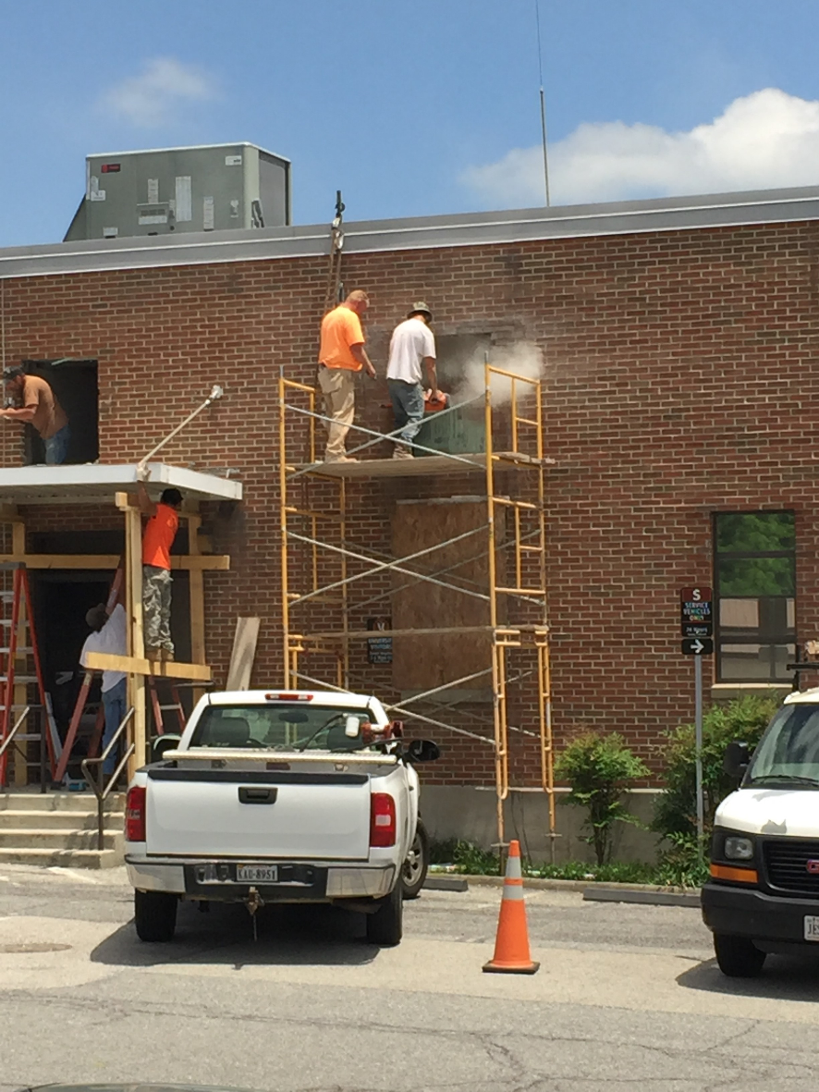
ACTIVITY TWO
What do you do when you have a safety concern with your job?
What do you do when you see unsafe activity in your workplace?
11
Notes:
ACTIVITY TWO
Purpose:
Correlate safety to common tasks;
Knowledge check of section one; can students demonstrate appropriate decisions based on circumstances they encounter;
Activity:
Break into small groups and have participants discuss and report out to the class.
Provide at least one of the following scenario-driven prompts:
Photo: Workers on scaffolding with no top rail, workers on ladder with two points of contact.
There is a large chunk of concrete missing from a step in the stairwell
A tractor or equipment step is damaged
The loading dock railings are damaged
A worker is climbing warehouse racks to reach product
If you’re the worker, what do you do when confronted with this situation?
If you’re the supervisor, what do you do when your employee approaches you with this?
What are your expectations from your employer?
Expected Response(s):
Students should verbalize:
Safety concerns should be brought to the attention of their employer (supervisor) first;
Notify OSHA if you believe there is a serious hazard or your employer is not following OSHA standards;
Exercise your limited right to refuse work as a last resort.

Slide 12
File a Complaint with OSHA
Workers may file a confidential complaint with OSHA if they believe a violation of a safety or health standard, or an imminent danger situation, exists in the workplace.
 | FILING A COMPLAINT WITH OSHA
 | ONLINE
 | FAX OR MAIL
 | BY CALLING 1-800-321-OSHA
 | IN PERSON AT AN OSHA OFFICE
12
Notes:
FILE A COMPLAINT WITH OSHA
Review slide content.
The Occupational Safety and Health Act of 1970 gives employees and their representatives the right to file a complaint and request an OSHA inspection of their workplace if they believe there is a serious hazard or their employer is not following OSHA standards. Workers do not have to know whether a specific OSHA standard has been violated in order to file a complaint. The complaint should be filed as soon as possible after noticing the hazard or lack of compliance because OSHA citations may only be issued for violations that currently exist or existed in the past 6 months. Written complaints that are signed by a worker or representative and submitted to the closest OSHA Area Office are more likely to result in onsite OSHA inspections. Please include your name, address and telephone number so we can contact you to follow up. Workers may request that their name not be revealed to the employer. If a worker files a complaint, they have the right to find out OSHA’s action on the complaint and request a review if an inspection is not made.
Complaints received from workers in OSHA-approved state plan states will be forwarded to the appropriate state plan for response.
Interaction with Class:
When is it appropriate to file a complaint with OSHA?
If you believe there is a serious hazard or their employer is not following OSHA standards. You do not have to know whether a specific OSHA standard has been violated in order to file a complaint. Complaints should be filed as soon as possible because OSHA citations may only be issued for violations that currently exist or existed in the past 6 months
So how do you file a complaint with OSHA or your state office?
Online through www.osha.gov (or your state office, if you’re in a state plan state).
By telephone. If there is an emergency or a hazard is immediately life-threatening, call 1-800-321-OSHA.
Complaints can be filed by Fax or Mail
Complaints can be filed in-person at any Area or Regional office.

Slide 13
OSHA Whistleblowers
You have a right to be heard. OSHA's Whistleblower Protection Program enforces the whistleblower provisions of more than twenty whistleblower statutes. Rights afforded by these whistleblower acts include, but are not limited to, worker participation in safety and health activities, reporting a work related injury, illness or fatality, or reporting a violation of the statutes. Protection from discrimination means that an employer cannot retaliate by taking "adverse action" against workers. You have 30 days to complain to OSHA if you believe your employer has taken an adverse action.
Adverse Actions | Adverse Actions | Adverse Actions
Firing or Laying Off | Failing to Hire or Rehire | Blacklisting
Demoting | Denying Overtime | Denying Promotion
Intimidation / Harassment | Making Threats | Disciplining
Denial of Benefits | Reducing Pay or Hours | Reassignment
13
Notes:
OSHA WHISTLEBLOWERS
Review slide content.
OSHA provides significant whistleblower protection for you. Your employer cannot take “adverse action” against you because you exercise any of your rights guaranteed to you by the OSH Act. Even in state-plan states, federal OSHA has jurisdiction over retaliation for whistleblower acts. You may also have protection under additional laws at the state level if you are in a state-plan state.
Adverse actions are things like firing / laying off, demoting, intimidating, denying benefits, failing to hire/rehire, denying overtime, making threats, reducing pay/hours, blacklisting, denying a promotion, disciplining, or reassigning an employee.
You must complain to OSHA within 30 days of the alleged reprisal to exercise your whistleblower protection.

Slide 14
Limited Right to Refuse Work
Employees have a limited right under the OSH Act to refuse to do a job because conditions are hazardous.
You may do so under the OSH Act only when:
You believe that you face death or serious injury (and the situation is so clearly hazardous that any reasonable person would believe the same thing);
You have tried to get your employer to correct the condition, and there is no other way to do the job safely; and
There is an imminent threat to an employee’s life, and there is not enough time to work through your employer or OSHA.
Regardless of any unsafe conditions, you are not protected if you simply walk off the job.
14
Notes:
LIMITED RIGHT TO REFUSE WORK
Review slide content.
Interaction with Class:
Can you provide an example of when it would be appropriate to exercise your limited right to refuse work?

Slide 15
Your Employer is Responsible for…
Providing a workplace free from recognized hazards and comply with OSHA standards
Providing training required by OSHA standards
Keeping records of injuries and illnesses
Providing medical exams when required by OSHA standards and providing workers access to their exposure and medical records
Not discriminating against workers who exercise their rights under the Act (Section 11(c)
Posting OSHA citations and hazard correction notices
Providing and paying for most PPE
15
Notes:
YOUR EMPLOYER IS RESPONSIBLE FOR…
As an employee, a lot of safety responsibilities fall directly to you. You have to follow safety policies and procedures, attend training, wear personal protective equipment, etc.
OSHA also outlines those things for which your employer is responsible for. You should notice that the first and foremost responsibility of the employer is not just compliance – it’s to actually provide a workplace free from recognized hazards. This aligns directly with the ‘General Duty” clause discussed before. Even if a hazard is NOT addressed in 29 CFR 1910 (or other document) your employer has an obligation to control it.
Review slide content.

Slide 16
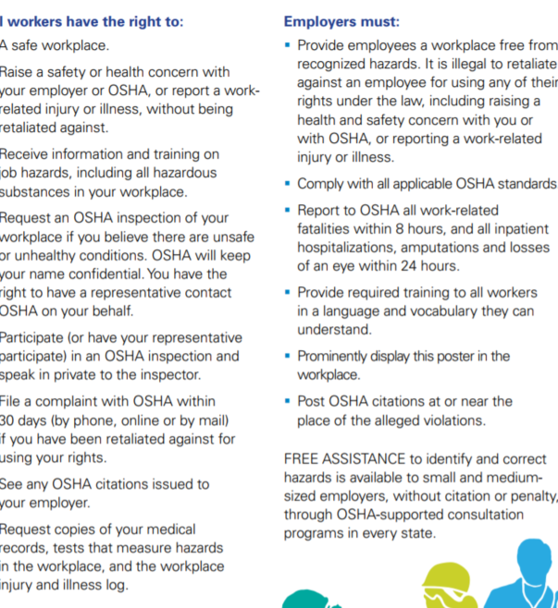
Job Safety & Health
It’s the Law!
Contacting OSHA 1-800-321-OSHA TTY 1-877-889-5627
www.osha.gov
16
Notes:
JOB SAFETY & HEALTH
Review key elements as section summary.
Interaction with Class:
Have you ever stopped to read this poster in your workplace?

Slide 17
Falls
17
Notes:
FALLS
Section 2 establishes the importance of falls in the workplace.
This section is designed to help students reach Objective 2.
Fall Protection in General Industry is NOT a replacement for an employer’s fall protection training program.

Slide 18
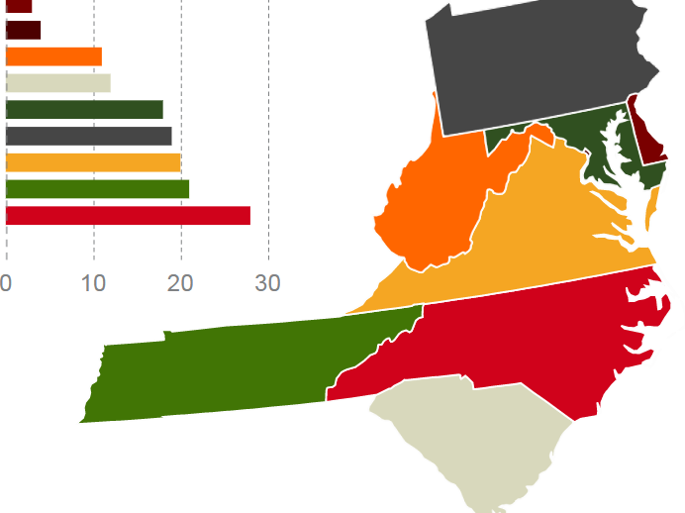
Falls
2017 Fatal Falls, Mid-Atlantic Region, By State
STATE | FATALITIES
Delaware | 3
District of Columbia | 4
West Virginia | 11
South Carolina | 12
Maryland | 18
Pennsylvania | 19
Virginia | 20
Tennessee | 21
North Carolina | 28
Source: US Bureau of Labor Statistics
18
Notes:
FALLS
Review slide content.
The total fatalities for the region was 136.
The chart displays the total number of fatal falls in 2017 for states in the Mid-Atlantic region.
Note:
Limit discussion of what these statistics represent. Students will break into groups for Activity Three and discuss these in detail.
Source:
U.S. Bureau of Labor Statistics State Occupational Injuries, Illnesses, and Fatalities Data https://www.bls.gov/iif/oshstate.htm

Slide 19
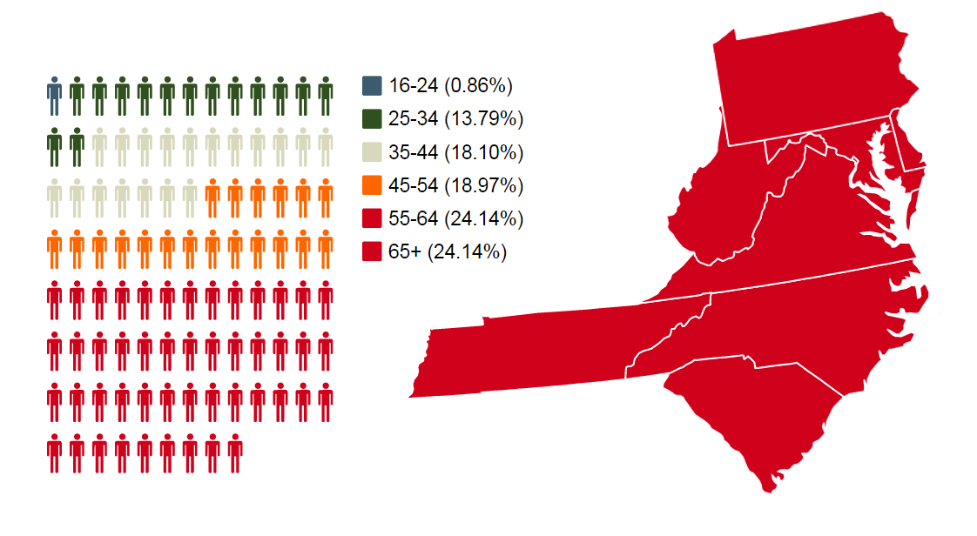
Falls
2017 Fatal Falls, Mid-Atlantic Region, By Age
Source: US Bureau of Labor Statistics
19
Notes:
FALLS
Review slide content.
The chart displays the victim’s age breakdown for fatal falls in 2017 for states in the Mid-Atlantic region. Be sure students recognize that 48.28% of fatal falls occurred in workers 55 or over.
Note:
Limit discussion of what these statistics represent. Students will break into groups for Activity Three and discuss these in detail.
Source:
U.S. Bureau of Labor Statistics State Occupational Injuries, Illnesses, and Fatalities Data https://www.bls.gov/iif/oshstate.htm

Slide 20
ACTIVITY THREE
Why do you think there are more fatal falls in Virginia, Tennessee and North Carolina? What reasons might there be for the trend in fatal falls as they relate to the age of the worker?
Source: US Bureau of Labor Statistics
20
Notes:
ACTIVITY THREE
Purpose:
Create a discussion the reasons for the trends in fatal falls shown on the previous two slides.
Activity:
Break into small groups and have participants discuss and report out to the class after five minutes.
Why do you think there are more fatal falls in Virginia, Tennessee, and North Carolina?
What reasons might there be for the trend in fatal falls as they relate to the age of the worker.
Expected Response(s):
Students should verbalize:
The higher prevalence of high-risk occupations in the states with higher incidences (i.e., agriculture, manufacturing, etc.);
The aging workforce in general; people working past the traditional retirement age; workers with underlying health problems that can contribute to falls.
Source:
U.S. Bureau of Labor Statistics State Occupational Injuries, Illnesses, and Fatalities Data https://www.bls.gov/iif/oshstate.htm

Slide 21
Authority
OSHA’s authority governing falls and related hazards is found in 29 CFR 1910, Subpart D, Walking-Working Surfaces.
Fall protection is specifically outlined in 29 CFR 1910.28. This section was recently rewritten and went into effect on January 17, 2017.
21
Notes:
AUTHORITY
Review slide content.
Reasons for the 2017 Regulatory Changes:
The rule incorporates advances in technology, industry best practices, and national consensus standards to provide effective and cost-efficient worker protection. Specifically, it updated general industry standards addressing slip, trip, and fall hazards (Subpart D), and adds requirements for personal fall protection systems (subpart I). OSHA estimates that these changes will prevent 29 fatalities and 5,842 lost-workday injuries every year.
The rule benefits employers by providing greater flexibility in choosing a fall protection system. For example, it eliminates the existing mandate to use guardrails as a primary fall protection method and allows employers to choose from accepted fall protection systems they believe will work best in a particular situation. In addition, employers will be able to use non-conventional fall protection in certain situations, such as designated areas on low-slope roofs. As much as possible, OSHA aligned fall protection requirements for general industry with those for construction, easing compliance for employers who perform both types of activities. For example, the final rule replaces the outdated general industry scaffold standards with a requirement that employers comply with OSHA's construction scaffold standards.

Slide 22
Workplace Hazards
Your employer is obligated to recognize, evaluate and control hazards found in your workplace.
This includes:
Recognizing when work tasks expose you to a fall hazard;
Evaluating those tasks and hazards;
Controlling those hazards to limit your risk of falls;
Ensuring personal protective equipment is available for use when hazards cannot be fully controlled; and
Making sure everyone is trained.
22
Notes:
WORKPLACE HAZARDS
Review slide content.
The concept of recognize, evaluate, control (REC) is a critical part of how your employer keeps you safe. Employers must perform (and document) that they have looked for hazards associated with:
The tasks you’re asked to perform;
The equipment and chemicals you’re asked to use; and
Where you perform work / use equipment.
For any hazards identified, your employer is legally required to find ways to keep you safe.
Interaction with Class:
What are some of the hazards your employer has already addressed in the workplace?
What controls protect you on a daily basis?

Slide 23
Fall Hazards
Recognizing & Evaluating Fall Hazards
23
Notes:
FALL HAZARDS
Section 3 is designed to help students meet Objective 3.
This section covers the types of falls and situations in which they occur.
There is also a tool provided to assess fall risk.

Slide 24
Falls on the Same Level
Even though most people think of falls as being from one level to another, many falls happen on the same level. Falls involving stairs also presents a significant risk.
Slips on the same level can occur due to flooring material and design, a worker’s footwear, or wet/uneven surfaces.
Falls involving stairs are also part of this category.
24
Notes:
FALLS ON THE SAME LEVEL
Review slide content.
Slips, trips and falls while climbing or descending stairs resulted in 4,310 lost-time injuries in 2018.
Interaction with Class:
Have you ever fallen on stairs? What caused to your fall?
What elements can contribute to falls on stairs? Expected responses include: lack of a handrail, unusual stair riser height or tread depth, stair materials (slate or tile without gripping surface); stair condition, carrying materials while using stairs, poor lighting while using stairs.

Slide 25
Falls from Height
Falls from a height of four (4) feet or greater from one level to another present a significant hazard to the worker.
Although most falls are under 15 feet, higher falls are associated with a greatly increased risk of injury or death.
§1910.28(b)(1)(i)(A-C)
Source: US Bureau of Labor Statistics
25
Notes:
FALLS FROM HEIGHT
Review slide content.
Key Data on Falls from Height:
81% of Fatal / Lost time Falls occur from a height of 6’ or less
92% occur at 10’ or less
Fewer than 2% of falls occur from more than 21 feet.
Standard Correlation: OSHA requires protection where working from any unguarded edge four feet or more above a lower level. [ §1910.28(b)(1)(i)(A-C) ]
“Except as provided elsewhere in this section, the employer must ensure that each employee on a walking-working surface with an unprotected side or edge that is 4 feet (1.2 m) or more above a lower level is protected from falling by one or more of the following: (A) Guardrail systems; (B) Safety net systems; or (C) Personal fall protection systems…”
Photo Note:
This photo was taken at Virginia Tech’s High-wall surface mine, where Hokie Stone (a local limestone) is mined and cut for use on our buildings. A dog became trapped on a ledge and required rescue. The individuals working both on the face and at the leading edge are protected from falls using personal fall protection. The animal was fine, and no Virginia Tech personnel or emergency responders were injured in the animal’s rescue.
Source:
U.S. Bureau of Labor Statistics Census of Fatal Occupational Injuries (CFOI) - Current and Revised Data
https://www.bls.gov/iif/oshcfoi1.htm

Slide 26
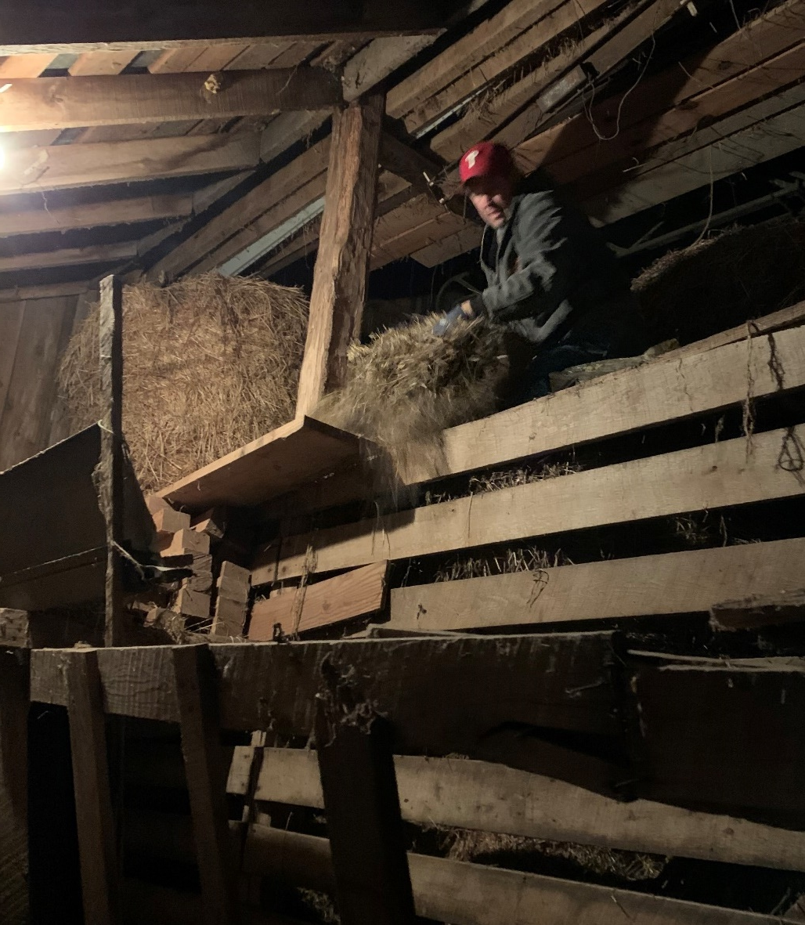
Falls from Height
There are many factors that can contribute to a fall from one level to another, including:
Lack of fall protection training
Precarious work positions
Excessive leaning or reaching
26
Notes:
FALLS FROM HEIGHT
Review slide content.
Interaction with Class:
What types of “precarious work positions” might you be in?
What common tasks can result in excessive leaning or reaching?

Slide 27
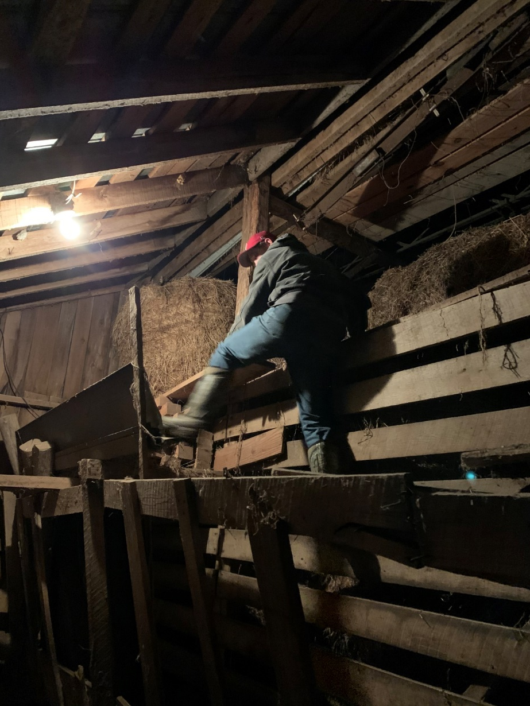
Falls from Height
Other factors that can lead to a fall:
Improper work practices
Unstable structures
27
Notes:
FALLS FROM HEIGHT
Review slide content.
Interaction with Class: How at risk is the pictured worker from a covered fall?
Describe one situation you’ve stood on something you knew wasn’t stable. Why did you do it?

Slide 28
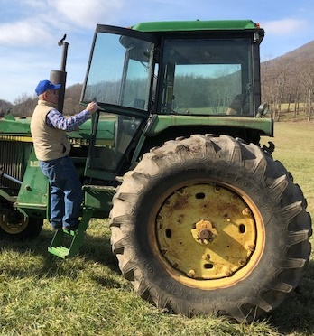
Falls from Height
Other factors that can lead to a fall include:
Trip hazards
Slippery surfaces
Distractions
28
Notes:
FALLS FROM HEIGHT
Review slide content.
Interaction with Class:
With regard to the pictured elderly worker:
What if the tractor steps were slick with rain or ice?
What if the steps are damaged or loose? What if the handrail is not properly attached or weakened / rusty?
What might distract you and contribute to a fall?

Slide 29
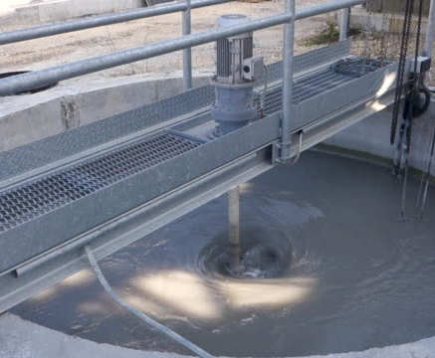
Falls onto or into Equipment
Falls into or onto dangerous equipment which may be hazardous can also lead to injury or death. This includes falls from any height into or onto:
Process or Pickling Tanks
Galvanizing Tanks
Degreasing Units
Unguarded Machinery
Energized Wires
Electrical Equipment
§1910.28(b)(6)
29
Notes:
FALLS ONTO OR INTO EQUIPMENT
Review slide content.
Standard Correlation: OSHA requires fall protection for any employee working where there a fall may occur into or onto dangerous equipment. “Each employee less than 4 feet (1.2 m) above dangerous equipment is protected from falling into or onto the dangerous equipment by a guardrail system or a travel restraint system, unless the equipment is covered or guarded to eliminate the hazard.” [ § 1910.28(b)(6)(i) ] “Each employee 4 feet (1.2 m) or more above dangerous equipment must be protected from falling by: (A) Guardrail systems; (B) Safety net systems; (C) Travel restraint systems; or (D) Personal fall arrest systems.” [ § 1910.28(b)(6)(ii)(A-D) ]
Note:
This type of fall is often overlooked when evaluating hazards.

Slide 30
Holes & Openings
Holes or openings through which someone can fall are a common hazard.
A hole is a gap or open space more than 2” in diameter in a floor or horizontal walking-working surface.
An opening is a gap or open space in a wall or vertical surface greater than 30” H and 18” W.
Unprotected vents or skylights are holes, and a common source of exposure.
§1910.21(b)
§1910.21(b)
§1910.28(b)(3)
30
Notes:
HOLES & OPENINGS
Review slide content.
A hole is a gap or void 2 inches or more in its least dimension in a floor, roof, deck, or other walking/working surface that is hazardous because workers can fall through the hole, the hole itself can create a tripping hazard, or because objects can fall through the hole and hit others on a lower level. [ §1910.28(b)(3) ]
An opening means a gap or open space in a wall, partition, vertical walking-working surface, or similar surface that is at least 30 inches (76 cm) high and at least 18 inches (46 cm) wide, through which an employee can fall to a lower level. [ §1910.28(b)(7) ]
Common holes include:
Skylights or ventilation openings
Holes cut in a floor or roof for machinery or access purposes;
Excavations for pits, wells, or shafts (e.g., caissons); and
Excavations or cuts in roadways.
Standard Correlation: OSHA requires employers to ensure each employee is protected from falling through holes and openings.
Holes and openings are defined in 29 CFR 1910.21(b).
The requirements for protecting employees from holes and openings is covered separately.
Holes, including skylights, are covered by 29 CFR 1910.28(b)(3).
Openings are covered under 29 CFR 1910.28(b)(7).

Slide 31
Excavations
While excavations are normally considered part of construction, non-construction workers often work nearby. When thinking of falls, people often think of falling from height to the ground.
Excavations present the same kind of risk of falling to another level, often with the added hazard of falling onto something. Employers must protect each employee at the edge of an excavation 6 feet or more in depth.
§1926.501(b)(7)
31
Notes:
EXCAVATIONS
Review slide content.
If excavations or trenches are present in the workplace, a competent person should be overseeing that aspect of the project. Part of the excavation competent person’s responsibility is to identify hazardous conditions. [ 29 CFR 1926.651(k)(1) ].
Interaction with Class:
Is the worker in the maroon shirt exposed to a fall hazard? What measures could be employed to protect the area? How important is worksite access control as part of fall protection?
Standard Correlation: OSHA requires fall protection for any employee working near excavations, trenches, wells, pits, etc. The OSHA Construction Standard (29 CFR 1926) governs these types of activities. “Each employee at the edge of an excavation 6 feet (1.8 m) or more in depth shall be protected from falling by guardrail systems, fences, or barricades when the excavations are not readily seen because of plant growth or other visual barrier” [ §1926.501(b)(7)(i) ]
“Each employee at the edge of a well, pit, shaft, and similar excavation 6 feet (1.8 m) or more in depth shall be protected from falling by guardrail systems, fences, barricades, or covers.” [ §1926.501(b)(7)(ii) ]

Slide 32
Ladders
Ladders are a common tool for transitioning between work levels, and in some cases serving as platforms.
A fall from a ladder usually occurs when the ladder is:
Not the right ladder for the job;
Damaged;
Unstable; or
Used improperly
32
Notes:
LADDERS
Review slide content.
Falls from portable ladders (step, straight, combination and extension) are one of the leading causes of occupational fatalities and injuries.
Common causes of falls from ladders include:
Using a damaged ladder
Using a ladder on slippery or unstable surface
Failing to lock in the ladder spreader
Standing on the top step or top cap
Exceeding the ladder’s rated load
Using a ladder in a high-traffic location
Overreaching while on the ladder
Using a ladder too closely to energized electrical wiring/equipment
Standard Correlation: 29 CFR 1910.23 is the standard governing ladders.
§ 1910.23(b) provides extensive guidelines for ladders and ladder usage.

Slide 33
Secondary Falls
Secondary falls are a new area of concern to employers.
Secondary falls occur when a worker has a fall where an existing medical condition is a contributing factor. These types of falls are especially common in workers 55 and older.
33
Notes:
SECONDARY FALLS
Review slide content.
Interaction with Class:
What types of tasks place workers 55 and older at an increased risk of falls? Why?
What challenges does this create for an employer?

Slide 34
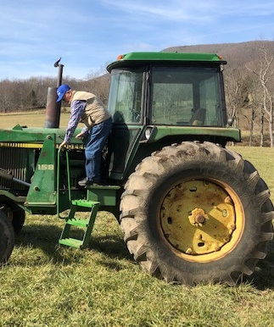
Secondary Falls
Fall hazards are compounded when individuals have medical conditions such as:
Diabetes
Cardiovascular Disease
Neurological Changes
Bone and Joint Changes
Changes to Vision, Hearing and Balance
In workers who have underlying medical conditions, falls from something as simple as climbing onto a piece of equipment can be especially hazardous.
34
Notes:
SECONDARY FALLS
Review slide content.
Photo:
A Giles County, Virginia resident dismounting a tractor.
Interaction with Class:
Consider the photo. You’re the employer of a service / maintenance worker. What challenges are there when protecting the worker sent out to service this equipment from fall hazards?

Slide 35
Evaluating Your Fall Risk
Are there slip or trip hazards?
Are there slick surfaces?
Do I have to move materials?
Is the lighting adequate?
Do I have to move from one working level to another?
What is the location of the work?
How far can I fall?
Is there anything I can fall into or onto?
35
Notes:
EVALUATING YOUR FALL RISK
Review slide content.

Slide 36
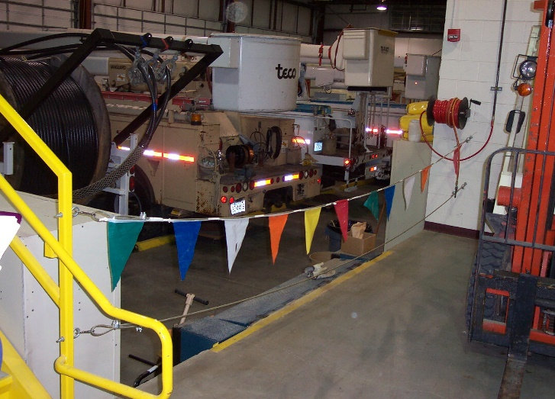
ACTIVITY FOUR
Identify the potential fall hazards in this photo.
Which hazard(s) do you think present the greatest risk?
What has been done to help reduce the risk of falls?
36
Notes:
ACTIVITY FOUR
Purpose:
Understand that fall hazards can take many forms; and
Using the tool on the prior slide, recognize various fall hazards in a given situation.
Key point: Falls do not have to be from a significant height.
Activity:
Working within the small group, have students answer the following questions based on the photo:
What hazards do you see in this photo?
What hazards do you think present the greatest risk?
What has been done to reduce the risk?
Expected Response(s):
Students should verbalize:
The presence of a difference in floor heights, the stairwell, the risk of using a powered industrial truck in close proximity to the edge, the use of wire rope guardrail that sags more than 3”
The difference in floor heights
Painting the leading edge yellow for visibility, painting of the stair rail extension for visibility, the use of pennant rope attached to the wire rope guardrail system

Slide 37
Fall Hazards
Controlling Fall Hazards
37
Notes:
FALL HAZARDS: Controlling Fall Hazards
Section Four covers the principles of controlling workplace hazards and serves as a foundation for identifying and implementing best practices. The concepts covered in this section are at the heart of “why” you use certain equipment, do things a certain way, and use your personal protective equipment.
This section helps students achieve Objectives 4 and 5.

Slide 38
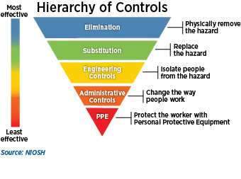
Hazard Controls
38
Notes:
HAZARD CONTROLS
The concept of hazard control is pretty easy to understand, and consists of five basic ways of keeping people safe. This typically involves five techniques (elimination, substitution, engineering controls, administrative controls, and personal protective equipment). To control hazards:
Eliminate or control all serious hazards (hazards that are causing or are likely to cause death or serious physical harm) immediately.
If necessary, find and use short-term controls while you develop and implement longer-term solutions.
Select controls that emphasize engineering solutions (including elimination or substitution) first, followed by safe work practices, administrative controls, and finally personal protective equipment.
Avoid selecting controls that may directly or indirectly introduce new hazards. Examples include exhausting contaminated air into occupied work spaces or using hearing protection that makes it difficult to hear backup alarms.
Review and discuss control options with workers to ensure that controls are feasible and effective.
Employers often have to use a combination of steps when no single method fully protects you.

Slide 39
Hazard Controls
Elimination of a hazard is always your first choice in controlling a fall hazard. With falls, this means you bring the work to ground level. Many routine tasks such as changing lamp bulbs can now be done from ground level.
39
Notes:
HAZARD CONTROLS
Review slide content.
Elimination and substitution, while most effective at reducing hazards, also tend to be the most difficult to implement. This high-mast light uses a cable system to lower light heads to the ground for bulb replacement and other maintenance tasks.
Interaction with Class:
What other ways can fall hazards be eliminated?

Slide 40
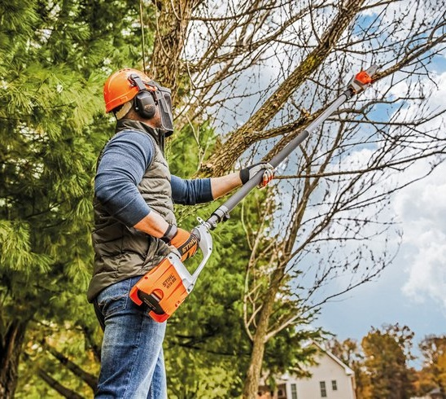
Hazard Controls
Elimination also includes tools which allow you to do the work from ground level.
Working from the ground level eliminates your risk for a fall.
40
Notes:
HAZARD CONTROLS
Review slide content.
Working from the ground level often requires different tools.
For example, in this photo the worker is using a pole saw. Working from the ground eliminates the potential for a fall from the tree while cutting limbs. The pole length also removes the worker from the area of falling limbs, reducing the potential for a “struck-by” hazard.
There are many types of “long arm” tools and attachments. The most common are poles that allow a worker to change lamps, clean ducts/grates or fans, or change signage without leaving ground level.
Interaction with Class:
Are there any work tasks that would be easier for you to do from ground level?
What tools do you need or procedural changes would allow you to do these tasks from the ground?

Slide 41
Hazard Controls
Part of the hazard elimination process is reducing the hazard by working from an appropriate platform. In this case, an articulating aerial lift provides a safer platform than working on the actual roof surface.
Using aerial lifts or building a scaffold structure are alternatives to working while exposed to a fall hazard.
41
Notes:
HAZARD CONTROLS
Review slide content.
Whenever possible, your first choice is to eliminate an exposure to a fall hazard.
When deciding how to approach a job, consider the following:
Can the job or work task be moved to ground level?
Is there a tool that will allow you to do the job from ground level?
Consider the use of scaffolding or an aerial lift (mobile scaffold).

Slide 42
Hazard Controls
§1910.29(b)(13)(i)
Engineering Controls remove the hazard from the workplace or use a barrier to virtually eliminate worker exposure to a hazard. The hazard is controlled on a relatively permanent basis.
Engineering controls are the most desirable and effective type of hazard control, but take time and resources to implement.
42
Notes:
HAZARD CONTROLS
Review slide content.
Elimination and substitution, while most effective at reducing hazards, also tend to be the most difficult to implement. Engineering controls are favored over administrative and personal protective equipment (PPE) because they control a worker’s exposure to the fall hazard. Well-designed engineering controls are effective because they don’t rely on you to do something or wear something. The initial cost of engineering controls can be high, and they can take time to implement. Once a hazard is identified, workers may have to use administrative controls and PPE until the engineering controls can be implemented.
Photo Note: Note the swinging gate at the top of the ladder.
Standard Correlation: “When guardrail systems are used around holes that serve as points of access (such as ladderways), the guardrail system opening Has a self-closing gate that slides or swings away from the hole, and is equipped with a top rail and midrail or equivalent intermediate member that meets the requirements in paragraph (b) of this section; or Is offset to prevent an employee from walking or falling into the hole.” [ §1910.29(b)(13)(i-ii) ]
Interaction with Class:
What are the engineering controls visible in this photograph? The guardrail system and swing gate are engineering controls.

Slide 43
Hazard Controls
The most common engineering control is a guardrail.
Guardrails can be temporary or permanent.
Guardrail systems consist of upright supports, toprails, midrails, and toeboards or screens when necessary.
§1910.29(b)
43
Notes:
HAZARD CONTROLS
Review slide content.
Guardrails consist of:
Upright supports attached to the working surface;
A horizontal top rail connected to the supports, 42” above the walking/working surface, ± 3” (39-45”);
One or more midrails running parallel to the top rail, halfway between the top edge of the toprail and the walking working surface, typically 21”; and
Toeboards when necessary to protect workers below from falling objects.
Toprails must withstand 200 pounds of force exerted in a downward or outward direction, while midrails must withstand 150 pounds of force in a downward or outward direction
Railings must be smooth-surfaced to protect employees from injuries and catching or snagging.
Parapet walls on roofs that are 39” above the walking-working surface can serve as a type of guardrail.
Standard Correlation: The relevant OSHA Standard for guardrail systems can be found in §1910.29(b)(1-15).

Slide 44
Hazard Controls
Holes are often protected by covers. OSHA has specific guidelines for hole covers.
When covers are used, they must be strong enough to support twice the expected load and secured to prevent accidental displacement.
Guardrail systems or safety net systems can also protect workers from holes.
§1910.29(e) , §1926.502(i)(1-4)
44
Notes:
HAZARD CONTROLS
Review slide content.
Covers are considered a fall protection system under 29 CFR 1910.29(e). Hole covers are strong protective surfaces used on walking/working surfaces or roadways to prevent workers from falling through a hole. Covers for permanent holes are typically built for a specific purpose (e.g., permanent access points, manhole covers, and trap doors) and are only effective when they are properly designed and secured in place. Covers for temporary holes are often constructed on work sites with reusable materials, most commonly using plywood and steel plates. For example, to cover large holes in a road, hinged steel plate covers can be used. Other options for covers include grates designed to support weight, custom boxes with an elevated lip or partially installed equipment, and temporary trapdoors.
Effective hole covers are:
Large enough to provide appropriate overlap to prevent workers from falling through.
Strong enough to support at least twice the anticipated weight imposed by the heaviest load (see 29 CFR 1926.502(i)(1), (i)(2)).
Left in place over the hole until access is needed.
Inspected periodically to identify deterioration.
Secured (see 29 CFR 1926.502(i)(3)) and do not create trip hazards.
Clearly marked as hole covers (see 29 CFR 1926.502(i)(4)).
Cardboard, drywall, wire fence material, tarps, plastic, glass or other materials not capable of bearing an anticipated load should not be used as hole covers. (Reference: OSHA Technical Manual)
Interaction with Class:
How does the legal requirement for a cover compare to what you see in practice?

Slide 45
Hazard Controls
Administrative Controls change how you do something. How you act or behave impacts how serious the hazard is to you. These controls make the task safer, but doesn’t eliminate the risk. You may still have to use personal protective equipment. Designated areas are a form of fall protection that relies on warning lines and distance to control the risk of a fall when working on low-slope roofs.
§1910.28(13) , §1910.29(d)
45
Notes:
HAZARD CONTROLS
Review slide content.
Administrative controls alter the way you perform a procedure or task so that “how” you perform it reduces the chances of you getting exposed to the hazard. Administrative controls rely on your actions/behaviors to control the hazard. Often, administrative controls alone may not fully protect you. In those cases, you may still have to use personal protective equipment. This photo illustrates the use of warning lines on a roof; they outline a designated area around an air handler. Workers are trained to work within the boundary of the warning lines.
Training you to work safely is another type of administrative control.
Standard Correlation: 29 CFR 1910.28(b)(13) provides for designated areas as a means of fall protection when working on a low-sloped roof.
29 CFR 1910.29(d) provides the requirements governing designated areas.

Slide 46
Hazard Controls
Designated areas on low-slope roofs must be clearly marked with rope, wire, tape or chain.
Anyone working outside the designated area is subject to normal fall protection guidelines.
§1910.28(b)(13) , §1910.29(d)
46
Notes:
HAZARD CONTROLS
Review slide content.
The use of designated areas does not physically prevent or arrest falls. Designated areas are typically used for specific situations, such as the installation of HVAC equipment on a roof, or finish work on low-slope roofs. On flat or low-sloped roofs, warning lines are normally used in conjunction with conventional fall protection or a safety monitoring system. There are also special guidelines in 29 CFR 1910.29(d)(3) governing the use of mobile mechanical equipment within a designated area.
Workers are not allowed in the area between the warning line and any unguarded edge more than four feet above another level, or otherwise presenting a fall hazard. Any worker doing tasks between a warning line and unguarded edge must be protected using another form of fall protection.
Standard Correlation: 29 CFR 1910.28(b)(13) provides for designated areas as a means of fall protection when working on a low-sloped roof. 29 CFR 1910.29(d) provides the requirements governing designated areas:
“When the employer uses a designated area, the employer must ensure: (i) Employees remain within the designated area while work operations are underway; and (ii) The perimeter of the designated area is delineated with a warning line consisting of a rope, wire, tape, or chain that meets the requirements of paragraphs (d)(2) and (3) of this section.” [ § 1910.29(d)(1) ]
“The employer must ensure each warning line: (i) Has a minimum breaking strength of 200 pounds (0.89 kN); Is installed so its lowest point, including sag, is not less than 34 inches (86 cm) and not more than 39 inches (99 cm) above the walking-working surface; (ii) Is installed so its lowest point, including sag, is not less than 34 inches (86 cm) and not more than 39 inches (99 cm) above the walking-working surface; (iii) Is supported in such a manner that pulling on one section of the line will not result in slack being taken up in adjacent sections causing the line to fall below the limits specified in paragraph (d)(2)(ii) of this section; (iv) Is clearly visible from a distance of 25 feet (7.6 m) away, and anywhere within the designated area; (v) Is erected as close to the work area as the task permits; and (vi) Is erected not less than 6 feet (1.8 m) from the roof edge for work that is both temporary and infrequent, or not less than 15 feet (4.6 m) for other work. “[ § 1910.29(d)(2) ]

Slide 47
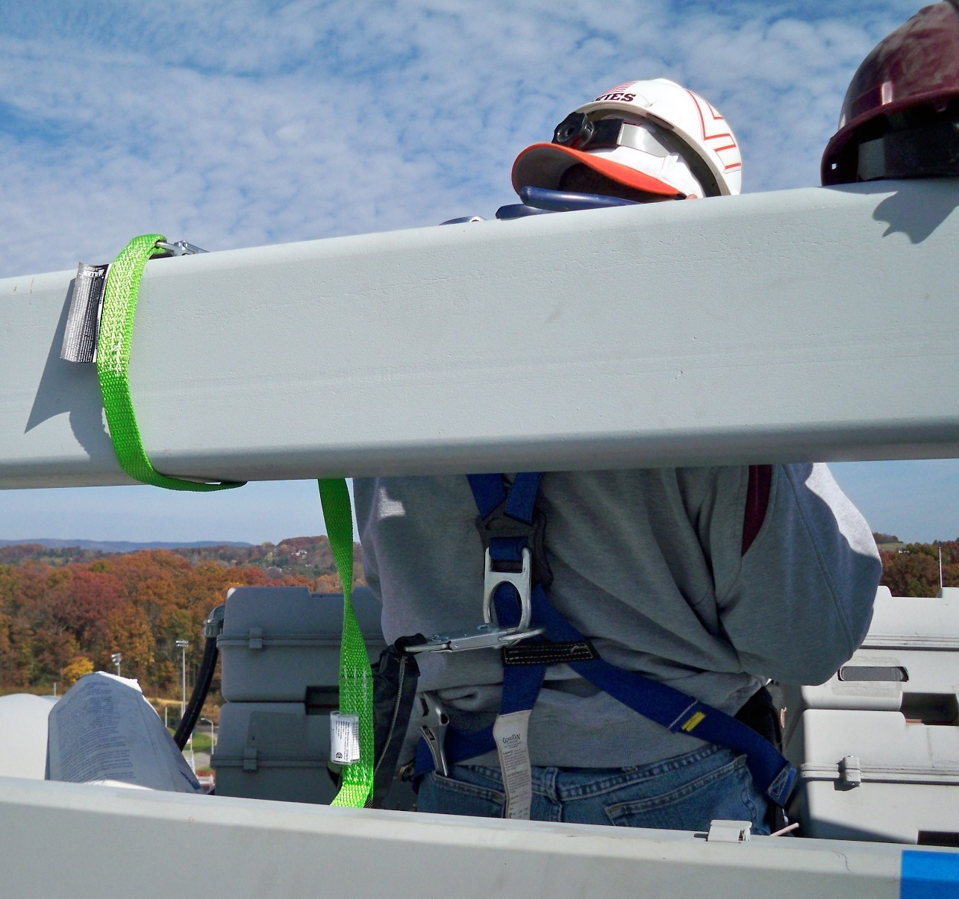
Hazard Controls
Personal protective equipment reduces your risk of serious injury or death due to the hazard. PPE does not eliminate the hazard, but can reduce the seriousness of injury.
PPE is used when engineering and administrative controls cannot completely control the hazard. The PPE used to protect you includes fall restraint and arrest systems.
47
Notes:
HAZARD CONTROLS
Review slide content.
Personal Protective Equipment (PPE) is your last line of defense against serious injury or illness. PPE is only used when your employer cannot fully eliminate the risk to you through elimination, substitution, engineering controls, or administrative controls. Gloves are the most common PPE, but there are many other types you may be asked to wear to protect you from hazards. In order for PPE to provide adequate protection, it must be worn and taken care of properly. The PPE you use for fall protection typically consists of a fall protection harness and connecting device. These items of PPE are used in conjunction with an anchor point to make up a personal fall arrest system or personal fall restraint system.
Interaction with Class:
Have you worn any PPE to protect you from a fall?
If so, what has your experience been?

Slide 48
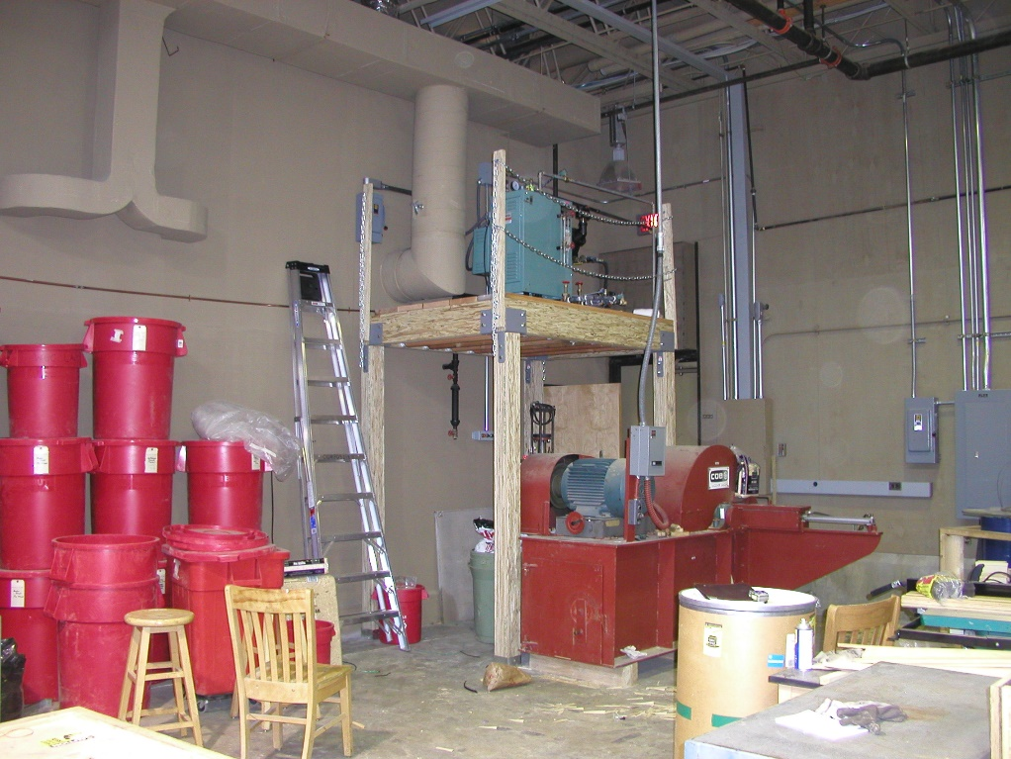
ACTIVITY FIVE
Identify the potential hazards in this photo.
Which hazard(s) do you think present the greatest risk?
What would you do to reduce the hazards in this space?
48
Notes:
ACTIVITY FIVE
Purpose:
Recognize when work presents a significant fall hazard.
Recognize various fall hazards in a given situation.
Key point: Hazards should be controlled by the employer.
Activity:
Working within the small group, have students answer the following questions based on the photo:
What hazards do you see in this photo?
What hazards do you think present the greatest risk?
What would you do to reduce the hazards in this space?
Expected Response(s):
Students should verbalize:
Panels (including a disconnect) on the elevated platform, the open-sided platform, the potential for a fall onto machinery, general slip/trip/fall hazards from generally poor housekeeping.
Any work done on the platform.
Use controls. Elimination – move the disconnect and any machinery that requires routine servicing or maintenance to ground level. Engineering - establish a permanent ladder with swinging gate and guardrails for the open side(s). Administrative – place warning signage and improve cleanliness. PPE – Install permanent anchor points to support any work on the platform.

Slide 49
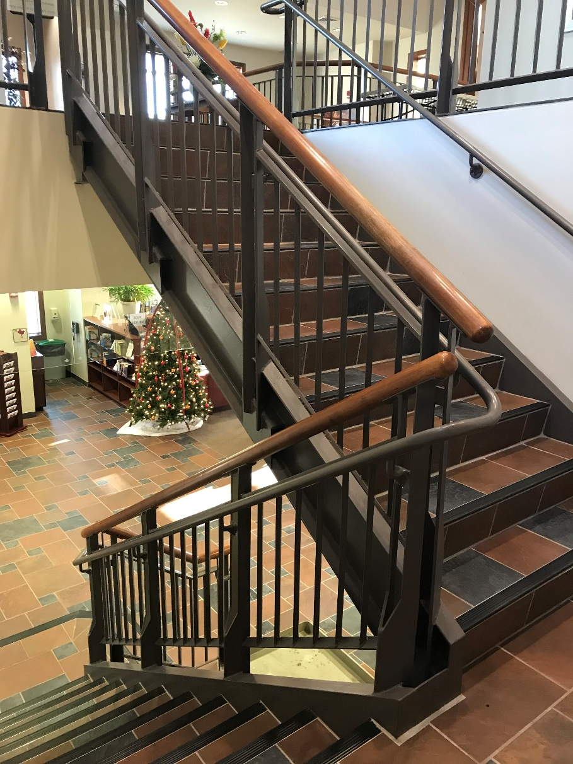
Stairs
Properly constructed stairs are a common hazard control. They allow workers to move from one level to another safely.
Stairs must have uniform riser heights and tread depths between landings.
Handrail
Stair Rail
Tread
Riser
Landing
§1910.25 (b)
49
Notes:
STAIRS
Review slide content.
Key parts of stairs include:
Handrails and stair rails must be installed according to the Standard. The standard is based on whether stairs are enclosed or open on one or both sides.
Treads are the part of the stair you walk on.
Risers are the vertical faces between treads.
Landings or platforms must be the same width as stairs and at least 30” in depth.
Interaction with Class:
Have you ever fallen on stairs?
What is the proper way to walk up or down stairs?
Standards Correlation:
The general requirements for stairways are covered in 29 CFR 1910.25(b).
Each flight of stairs having at least 3 treads and at least 4 risers is equipped with stair rail systems and handrails as outlined in Table D-2 — Stairway Handrail Requirements. [ § 1910.28(b)(11)(ii) ]
Stairway landings and platforms are at least the width of the stair and at least 30 inches (76 cm) in depth, as measured in the direction of travel [ § 1910.25(b)(4) ].

Slide 50
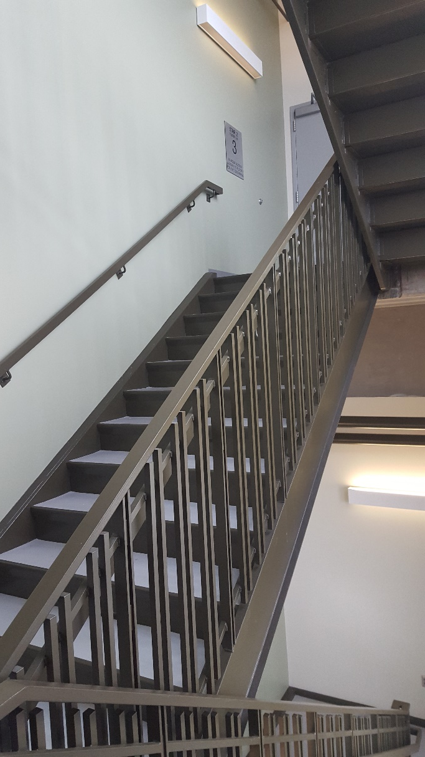
Stairs
Standard stairs:
Are installed at angles 30 to 50 degrees from horizontal
Have a maximum riser height of 9.5 inches
Have a minimum tread depth of 9.5 inches
Have a minimum width of 22 inches
Have a minimum vertical clearance of 6’ 8” at the leading edge of the tread
§1910.25 (c)
50
Notes:
STAIRS
Review slide content.
Standards Correlation:
The general requirements for standard stairs are covered in 29 CFR 1910.25(c).

Slide 51
Repair Pits
Many vehicle repair or maintenance centers utilize repair or service pits. These pits allow workers to access and assemble, install, maintain or repair components underneath a vehicle.
Repair and service pits can present a fall hazard to both workers.
51
Notes:
REPAIR PITS
Review slide content.
Repair pits under 10 feet in depth are identified specifically in 29 CFR 1910.28(b)(8) as special type of fall hazard. Repair pits with a depth greater than 10 feet require typical fall protection systems.
Photo Note: This service pit was found abandoned and partially filled with debris adjacent to a Civil Engineering research space at Virginia Tech. After consultation with various internal entities, the service pit was backfilled and closed.
Interaction with Class:
Where have you seen service pits of this type? How did the workplace ensure workers or others did not fall into the pit?
Standard Correlation: Repair pits, service pits and assembly pits less than 10 feet in depth are covered in § 1910.28(b)(8).

Slide 52
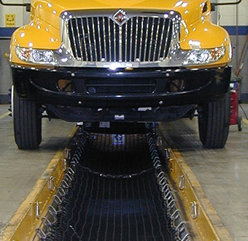
Repair Pits
Fall protection systems are not required for pits less than 10 feet deep as long as the employer:
Limits access within 6 feet of the edge of the pit to authorized, trained employees
Applies floor markings at least 6 feet from the edge of the pit or places an appropriate warning line around the edge of the pit; and
Posts readily visible caution signs meeting §1910.145 and stating “Caution – Open Pit.”
Pits that are more than 10’ deep or do not meet the above requirements must use fall protection systems such as guardrails or safety nets to protect workers.
§1910.28(b)(8)
52
Notes:
REPAIR PITS
29 CFR 1910.28(b)(8)(i-iii) provides employers an option to traditional fall protection systems for pits less than 10 feet in depth.
Review slide content.
Interaction with Class:
Have you seen any pits where an employer has exercised this option?
Standard Correlation: “Repair pits, service pits, and assembly pits less than 10 feet in depth. The use of a fall protection system is not required for a repair pit, service pit, or assembly pit that is less than 10 feet (3 m) deep, provided the employer: (i) Limits access within 6 feet (1.8 m) of the edge of the pit to authorized employees trained in accordance with §1910.30; (ii) Applies floor markings at least 6 feet (1.8 m) from the edge of the pit in colors that contrast with the surrounding area; or places a warning line at least 6 feet (1.8 m) from the edge of the pit as well as stanchions that are capable of resisting, without tipping over, a force of at least 16 pounds (71 N) applied horizontally against the stanchion at a height of 30 inches (76 cm); or places a combination of floor markings and warning lines at least 6 feet (1.8 m) from the edge of the pit. When two or more pits in a common area are not more than 15 feet (4.5m) apart, the employer may comply by placing contrasting floor markings at least 6 feet (1.8 m) from the pit edge around the entire area of the pits; and (iii) Posts readily visible caution signs that meet the requirements of §1910.145 and state "Caution — Open Pit."” [ §1910.28(b)(8)(i-iii) ]

Slide 53
Ladder Safety Systems
Ladder safety systems are required for newly installed or replaced fixed ladders over 24 feet in length.
§1910.28(b)(9)
53
Notes:
LADDER SAFETY SYSTEMS
Review slide content.
Ladder safety systems (ladder safety devices) provide fall protection when climbing fixed ladders.
Ladder safety systems typically include a body harness, connecting device (shuttle or carabiner), and a vertical lifeline or fixed carrier rail.
Workers wear the harness, which connects to system with a carabiner. Systems use a cable/safety sleeve, shuttle, or cable grab which connects the worker to the vertical line or rail. The cable grab or shuttle freely travels up or down the lifeline/rail as the worker ascends or descends the ladder, allowing the worker to maintain full contact with the ladder. In case of a fall, the shuttle or cable grab locks automatically and arrests the fall.
A ladder climbing system is not a "climb assist" system, which uses motorized equipment that to help a worker climb.
Standard Correlation: “Fixed ladders (that extend more than 24 feet (7.3 m) above a lower level).” [ §1910.28(b)(9) ]
“For fixed ladders that extend more than 24 feet (7.3 m) above a lower level, the employer must ensure: (A) Existing fixed ladders. Each fixed ladder installed before November 19, 2018 is equipped with a personal fall arrest system, ladder safety system, cage, or well; (B) New fixed ladders. Each fixed ladder installed on and after November 19, 2018, is equipped with a personal fall arrest system or a ladder safety system;” [ §1910.28(b)(9)(i) ]

Slide 54
Fall Restraint Systems
Fall restraint systems prevent you from reaching an unguarded edge or otherwise limit a fall distance to two feet or less.
Fall restraint systems are unique to the work site, work task, and employer. Your employer should provide additional training if you are expected to use a fall restraint system.
§1910.28(b), §1910.140
54
Notes:
FALL PROTECTION
Review slide content.
Fall restraint systems (also called travel restraint systems or positioning systems) are used prevent the user from having a fall of any distance. Employers have to determine the force needed to restrain a worker by looking at the forces generated by the worker’s walking, leaning, or sliding down the working surface. Fall restraint systems should have the capacity to withstand at least 3,000 pounds of force or twice the maximum expected force to restrain the worker.
Standard Correlation: Travel Restraint Systems (Fall Restraint Systems) are covered under multiple sections of the Standard:
29 CFR 1910.21(b) defines travel restraint system.
29 CFR 1910.28(b) identifies numerous areas where an employer has a duty to provide fall protection, and specifically identifies travel restraint systems as an option for many of those areas.
“Personal fall protection systems. Body belts, harnesses, and other components used in personal fall arrest systems, work positioning systems, and travel restraint systems must meet the requirements of §1910.140” [§ 1910.29(j) ]
29 CFR 1910.140 falls within the Personal protective equipment Subpart and establishes performance, care, and use criteria for all personal fall protection systems, including travel restraint systems.

Slide 55
Fall Arrest Systems
Personal fall arrest systems (PFAS) exist so that if you have a fall, the fall distance is limited to six feet or less.
PFAS are unique to the work site, work task, and employer. Your employer should provide additional training if you are required to use a PFAS.
§1910.28(b), §1910.140
55
Notes:
FALL PROTECTION
Review slide content.
A PFAS is a system with components that work together to protect workers when they fall from elevated heights. PFAS components include an anchorage, connectors, and a full-body harness, and may include a shock-absorbing lanyard, a retractable lifeline, and/or a deceleration device. PFAS components will be marked by the manufacturer with pertinent information specific to the equipment, such as warnings, serial/model number, capacity, and the materials used to make the component (see Figure 14). Information (e.g., proper use, maintenance, inspection) about fall protection components is typically provided in equipment manuals.
Although some components may look the same, they may not be interchangeable if they are from different manufacturers or from different equipment series made by the same manufacturer.
Standard Correlation: Personal Fall Arrest Systems are covered under multiple sections of the Standard:
29 CFR 1910.28(b) identifies numerous areas where an employer has a duty to provide fall protection, and specifically identifies personal fall arrest systems as an option for many of those areas.
“Personal fall protection systems. Body belts, harnesses, and other components used in personal fall arrest systems, work positioning systems, and travel restraint systems must meet the requirements of §1910.140” [§ 1910.29(j) ]
29 CFR 1910.140 falls within the Personal protective equipment Subpart and establishes performance, care, and use criteria for all personal fall protection systems.

Slide 56
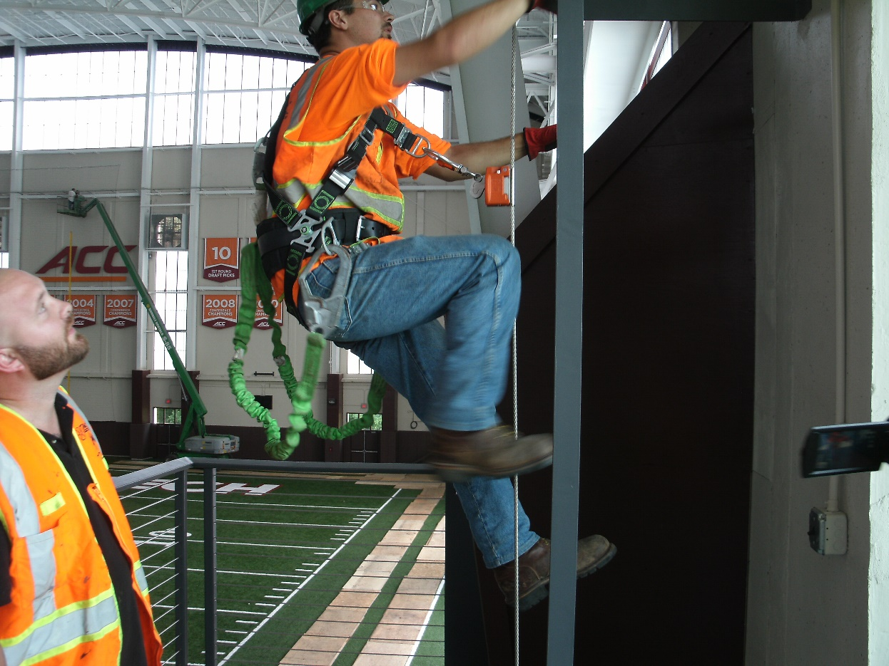
ACTIVITY SIX
What fall hazards are visible in this photo?
What hazard controls are visible in this photo?
56
Notes:
ACTIVITY SIX
Purpose:
Determine whether students are developing a relationship between work tasks, hazards, and PPE; and
Assess and assure student ability to correctly identify potential fall hazards.
Activity:
Break into small groups. Have students discuss the two questions presented and create a list of everything reported by the groups.
What fall hazards are visible in this photo?
What hazard controls are visible in this photo?
Expected Response(s):
Students should verbalize:
Fall hazards include the worker climbing the fixed ladder, the worker standing on the platform, and the worker(s) using the articulating lift in the background.
Hazard controls visible include:
Guardrail on platform (note the wire in lieu of the midrail)
Ladder safety system on the fixed ladder, with worker using LSS and having PFAS for elevated work.
Guardrails on articulating lift, with PFAS in use by workers.
PPE in use: Reflective vest, work boots, gloves, safety glasses.

Slide 57
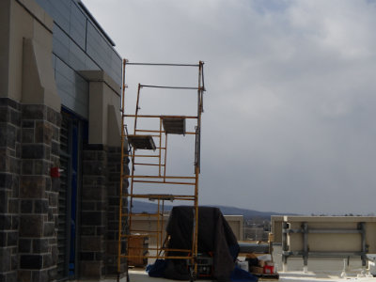
Fall Protection and Feasibility
What does the word “feasible” mean?
Is fall protection always feasible?
What do you think OSHA would say to an employer who says fall protection isn’t feasible?
57
Notes:
FALL PROTECTION AND FEASIBILITY
Review slide content and pose questions to class.
Interaction with Class:
Go around the room and ask students to define “feasible” or “infeasible”.
Is fall protection always feasible?
Are there situations where you think fall protection may be infeasible?
If you are a compliance officer visiting a workplace, what does “infeasible” mean? What is your presumption.

Slide 58
Fall Protection and Feasibility
Infeasible means that it is impossible to perform the work while using a conventional fall protection system, or that it is technologically impossible to use a conventional system.
“Infeasible” is strictly defined by OSHA.
OSHA presumes that fall protection is feasible and will not create a greater hazard to use at least one of the above-listed fall protection systems specified in paragraph (b)(1)(i) of this section.
The employer has the burden of establishing that fall protection is not feasible or creates a greater hazard to provide the fall protection systems specified in paragraph (b)(1)(i) and that it is necessary to implement a fall protection plan that complies with §1926.502(k) in the particular work operation, in lieu of implementing any of those systems.
[ §1910.28(b)(1)(i), Note ]
58
Notes:
FALL PROTECTION AND FEASIBILITY
Review slide content.
Point out that difficult to install/use, expensive, cumbersome, etc. does not equate to the definition of infeasible, therefore fall protection should be used. Other responses may fall into the exemptions (scaffold erection/dismantling, steel work, etc.).
Standards Correlation:
29 CFR 1910.28(b)(1)(i) has a specific note that addresses feasibility and fall protection.

Slide 59
Best Practices
59
Notes:
BEST PRACTICES
Section 5 introduces a collection of best practices related to fall protection in general industry. A “best practice” is a way of doing things that leads to a desired result. Best practices are not usually a legal requirement – i.e., not following them won’t get your employer fined by OSHA. Many employers adopt best practices as part of your procedures. These best practices represent ways of doing things that will help you work safely, and reduce the risk of illness or injury due to chemicals.
This section specifically addresses Objective 5.

Slide 60
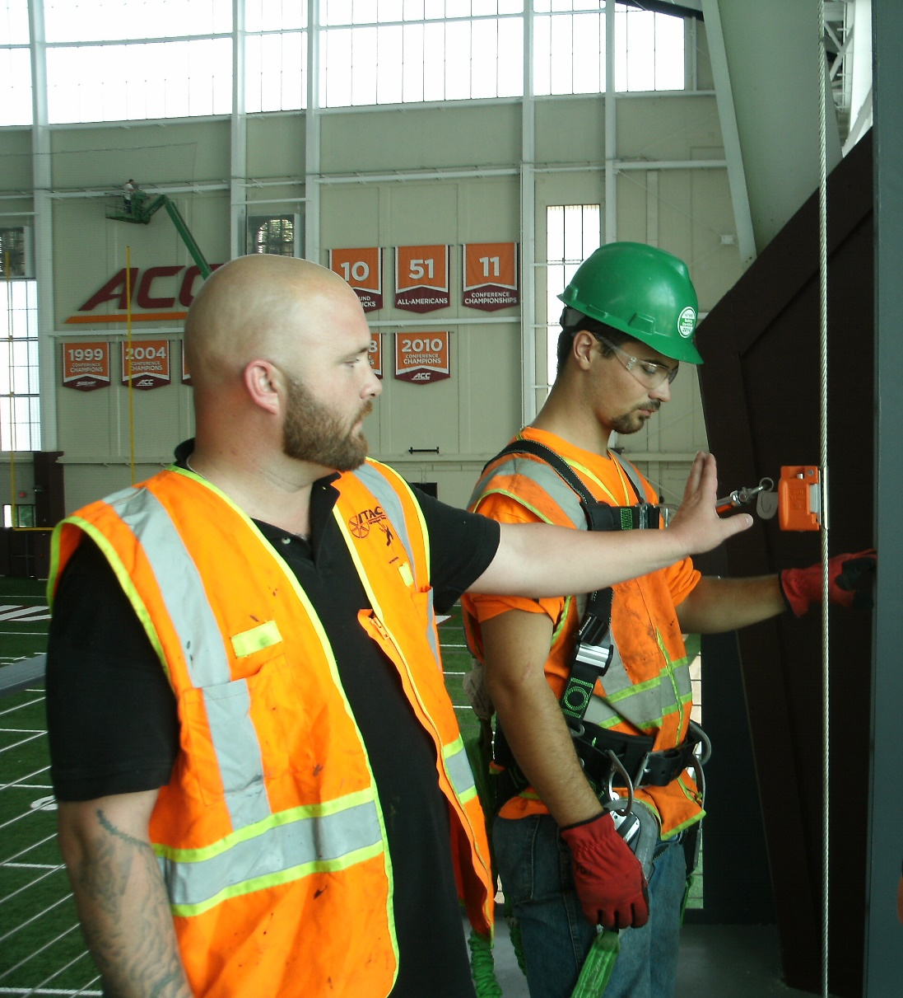
Best Practices
Get everyone involved.
Falls remain a leading cause of injury and death in the workplace, despite years of significant efforts by safety professionals and regulators.
One of the keys to success in a fall prevention program is to ensure it involves your entire workplace.
60
Notes:
BEST PRACTICES
Review slide content.
Photo Note:
This photo is during a class for new videographers for the VT athletics department. These individuals work on a catwalk and must climb fixed ladders using ladder safety systems to perform their work.
Fall protection is a cooperative effort between athletics, student workers, and VT EHS.
Interaction with Class:
Do you think the individuals shown in the photo realize they are at risk of a fall?
Why is this a best practice?
How might this be implemented in your workplace?

Slide 61
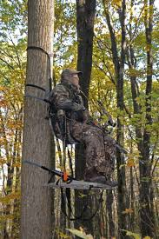
Best Practices
Learn to recognize, evaluate and control falls everywhere – not just at work.
When you are injured by a fall away from work, your absence impacts your employer!
61
Notes:
BEST PRACTICES
Review slide content.
Non-workplace falls have a significant impact on your employer.
These types of falls can occur from ladders, hunting stands, or even retaining walls. Slips, trips and falls at home happen in very similar ways, and can be prevented with the same recognize, evaluate, and control approach.
For example, falls from hunting stands remain common and carry a high rate of spinal / neurological injury.
Compared to the average workplace fall, which is under 15 feet, the average fall from a tree stand is greater than 18 feet.
Spinal fractures (54%) and head injuries (22%) are the two most common injuries, and workers are hospitalized an average of 6-7 days.
Source: Pierre CA, Plog BA, Srinivasan V, Srinivasan K, Petraglia AL, Huang JH. Tree stand falls: A persistent cause of neurological injury in hunting. World J Clin Cases. 2014;2(8):345–350. doi:10.12998/wjcc.v2.i8.345
Interaction with Class:
How long would a worker, having fallen from a ladder or tree stand, be out of work?
What other reasons make this a best practice?
How might this be implemented in your workplace?

Slide 62
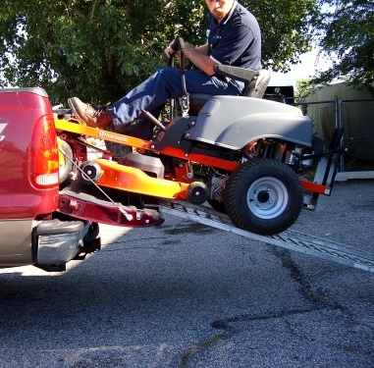
Best Practices
Avoid improvising.
Use the right equipment for the task. Even a fall from less than four feet can have life-changing implications.
62
Notes:
BEST PRACTICES
Review slide content.
One of the challenges with fall protection is that people become complacent and fail to recognize when they are creating and exposing themselves to a fall hazard. This can also be due to time pressures (a worker would have to go to a different location to get the correct equipment to do the job safely). Workers improvising or “making do” can contribute to safety issues.
Interaction with Class:
Just by looking at the photo, what can you say about the mower, ramps, and tailgate/truck?
Do you think the individual shown in the photo realizes he is at risk of a fall?
Why is this a best practice?
How might this be implemented in your workplace?

Slide 63
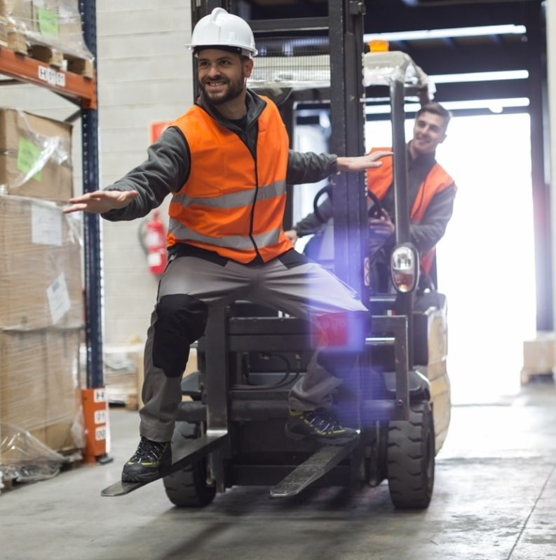
Best Practices
Prevent horseplay at work.
Everyone likes to have fun, but certain actions carry a high risk of injury – forklift surfing, or foot races around the facility, for example.
Workers have also faced criminal charges when horseplay has resulted in injury or death.
63
Notes:
BEST PRACTICES
Review slide content.
Photo Note:
This is a photo of “forklift surfing” in a warehouse.
Interaction with Class:
How much does horseplay impact a workplace?
What horseplay have you observed? How did it create hazards?
Why is this a best practice?
How might this be implemented in your workplace?

Slide 64
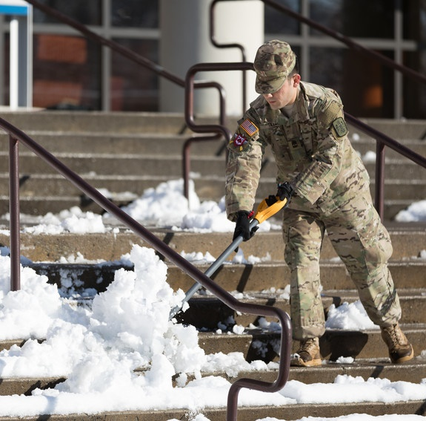
Best Practices
Watch out for weather.
Falls at the same level occur more frequently when walking surfaces are wet, snowy or icy. Make sure you have a plan to manage walking-working surfaces. Be sure employees working on wet, snowy or icy surfaces have proper footwear.
64
Notes:
BEST PRACTICES
Review slide content.
Remember that walkways, parking lots and other walking-working surfaces where employees are engaged in job tasks, or that a worker may encounter as a condition of employment are considered part of the employer’s establishment. Account for all employee tasks – including those who are assigned to spread salt or shovel snow and ensure employees assigned to such tasks have proper PPE.
Photo Note:
This is a photo of a Virginia Tech Corps of Cadets member shoveling snow in front of a campus building.
Interaction with Class:
What if your workplace involves shared/common or public spaces outside your employee’s control?
Why is this a best practice?
How might this be implemented in your workplace?

Slide 65
Best Practices
Move materials safely.
Lifting and moving items by hand increases your risk of a fall. Use hand trucks, carts, powered industrial trucks, or other means to lift, move and carry objects.
65
Notes:
BEST PRACTICES
Review slide content.
Many slips, trips and falls occur while trying to move objects. Heavy, bulky, or awkward shaped items can interfere with your ability to see things likes curbs or stairs. Use appropriate material-handling equipment whenever possible.
Photo Note:
Virginia Tech provides wheeled carts and closes off streets adjacent to residence halls during student move-in. The carts reduce this risk of trips or falls while carrying objects, as students must often navigate steps and curbs. Closing off streets and helping students park near their assigned buildings reduces the distance required, as well as minimizes the risk of a pedestrian being struck by a vehicle.
Interaction with Class:
What types of objects are normally moved by hand in your workplace? How might they be more safely moved?
What material handling equipment do you have available in your workplace?
Why is this a best practice?
How might this be implemented in your workplace?

Slide 66
Best Practices
Respect stairs.
Stairs are a frequent location for falls. Use handrails, walk one step at a time, and avoid carrying objects that place you off-balance or limit your view of the stairs.
66
Notes:
BEST PRACTICES
Review slide content.
Generally, stairs with more than four risers must have a stairrail. A stairrail system ensures workers cannot fall from an unprotected side to a lower levels. Handrails provide a handhold for workers to grasp during climbing / descending stairs. Stairs constructed prior to January 2017 may have an integrated handrail / stairrail between 36” – 38” from the tread. Stairs constructed after January 2017 should have a stairrail at 42” high, with a separate handrail between 30-38” from the tread.
Interaction with Class:
Why is this a best practice?
How might this be implemented in your workplace?

Slide 67
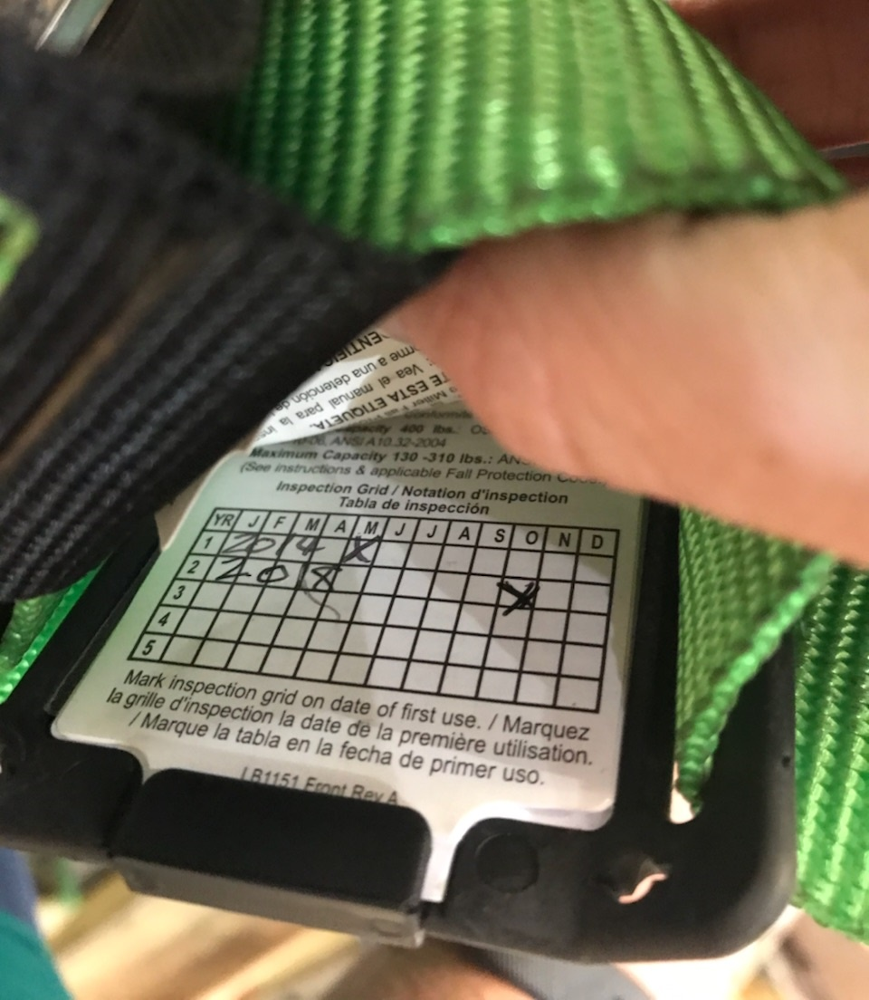
Best Practices
Inspect, inspect, inspect.
Damaged or defective equipment, improper anchor points, and equipment misuse all have been identified as contributing to fatalities or serious injuries. Know your equipment and its limitations. If you don’t inspect, you can’t expect it to perform properly.
67
Notes:
BEST PRACTICES
Review slide content.
Interaction with Class:
Why is this a best practice?
How might this be implemented in your workplace?

Slide 68
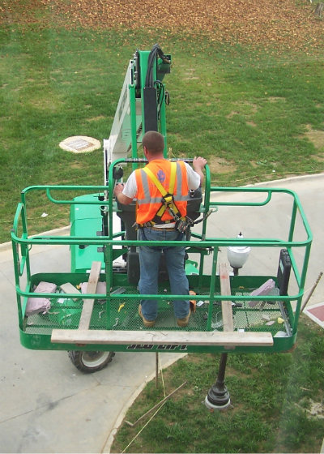
Best Practices
Use the safety systems provided, properly.
Your employer’s efforts to protect you from known hazards only protect you if you actually use them. Use them the right way, and only in the manner intended.
68
Notes:
BEST PRACTICES
Review slide content.
Interaction with Class:
Why is this a best practice?
How might this be implemented in your workplace?

Slide 69
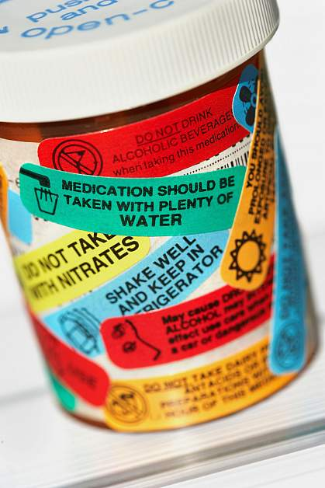
Best Practices
Work Sober.
Many medications can impact your balance, judgment and perception. Know the side effects of any prescription or over-the-counter medications. Never work under the influence of alcohol or drugs that may increase your risk of falls.
69
Notes:
BEST PRACTICES
Review slide content.
Interaction with Class:
Why is this a best practice?
How might this be implemented in your workplace?

Slide 70
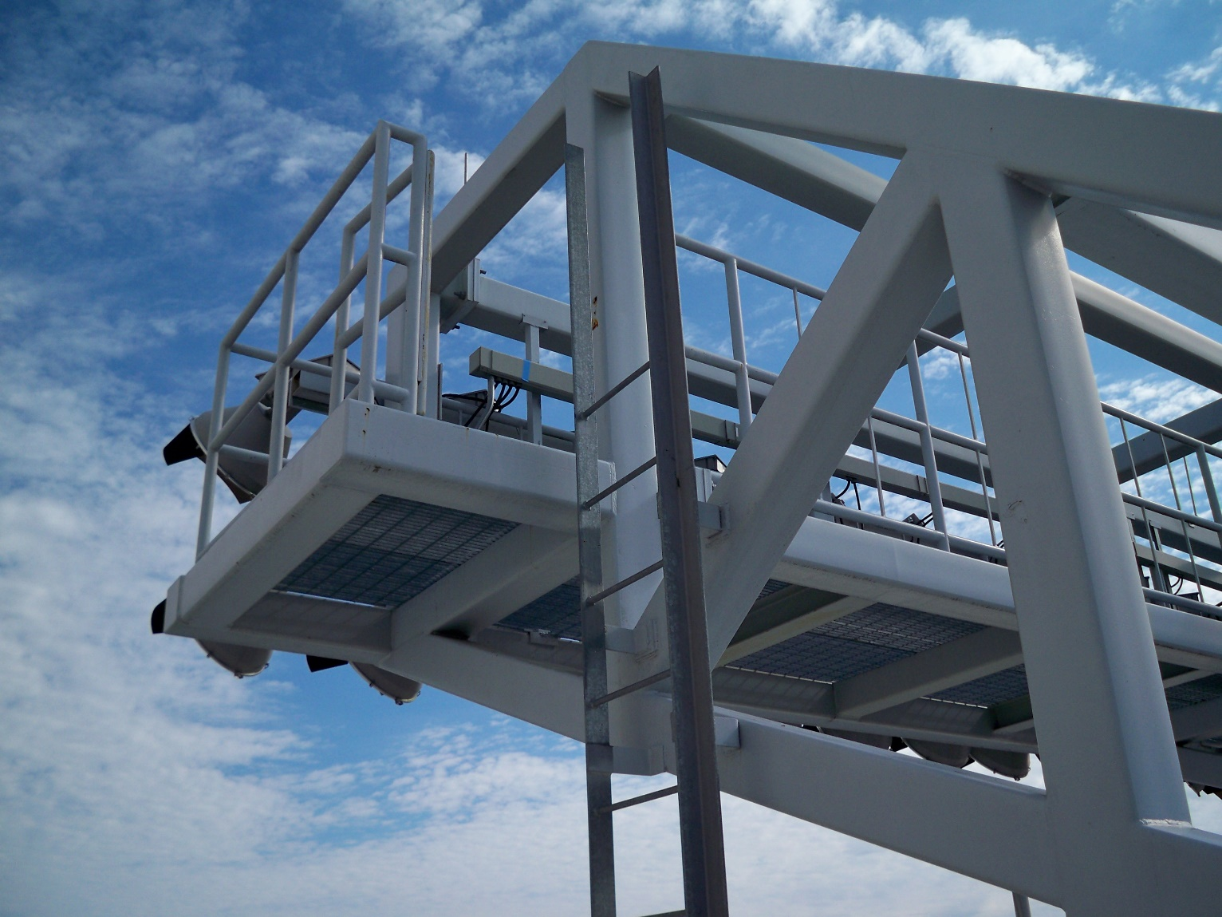
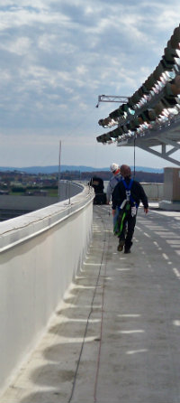
ACTIVITY SEVEN
You are the supervisor for an electrician. A work order comes in to change the light bulbs in a bank of stadium lights.
What are the risks? How might you control them for this employee?
70
Notes:
ACTIVITY SEVEN
Purpose:
Correctly use the principles discussed in the previous sections to recognize, evaluate and control fall hazards.
Activity:
Break into small groups.
What are the risks?
How might you (the supervisor) control those risks?
Follow-On Questions:
If this was a coworker, how might you address him/her?
What if you were working for a new employer, and this was your supervisor teaching you “their” way of doing things?
Expected Response(s):
Students should verbalize:
Risks include getting roof access; climbing the fixed ladder; transitioning from the fixed ladder to the platform; having to reach/extend beyond the guardrail in order to perform the work task.
Controls suggested should include: using LED or longer-lasting bulbs to reduce frequency of changes; changing all bulbs at once to reduce frequency of exposure; use of personal fall arrest system; establishment of anchor points on the structure for workers using PFAS

Slide 71
Review
71
Notes:
REVIEW
The primary goal of the review and closing statement is threefold:
Review key content points;
Conclude the class by ensuring student learning outcomes are met; and
Establish common ground for communication and innovation amongst participants.

Slide 72
In Closing…
Work closely with your supervisor(s) on all hazards in your workplace.
Falls can take many forms, mainly falls onto the same levels, falls onto a different level, and falls into/onto other hazards. Learning to recognize when you are exposed is a major part of protecting yourself.
Your employer uses a number of controls to protect you from known hazards. Inspect and use fall protection systems provided by your employer.
72
Notes:
IN CLOSING…
Review slide content, specifically the learning objectives. The principal objective of this review slide is to determine whether the individual students feel they have achieved the learning objectives for this class.
Now that we’ve finished the course, do you feel like you can:
Exercise your rights as an employee protected by the Occupational Safety and Health Act;
Understand the risk fall hazards present in the workplace, especially for today’s aging workforce;
Recognize when you may be exposed to a fall hazard;
Evaluate your risk of a fall when a fall hazard is present; and
Use controls and PPE to minimize your risk of a fall.
ADMINISTER POSTTEST & EVALUATION
Distribute posttest, answer sheet, and class evaluation.
Student Instructions: Please print your name and today’s date on the Answer Sheet. Do not mark on the test, use only the Answer Sheet. For each question, mark one and only one answer on the Answer Sheet.
Read each question and distractor aloud.
Encourage students to provide constructive feedback on class evaluation.
Collect posttest, answer sheet, and evaluation.
Total time to complete posttest should be 15 minutes.

Slide 73
In Closing…
Managing the risks associated with your work is a shared responsibility. Laws, training, and workplace policies are only small part of what makes a workplace safe. We encourage each of you to be innovative as you work with each other, your supervisors, and senior managers to create a safe and healthful workplace. Ask questions, talk openly, and share your ideas and solutions with each other.
Fall Protection in General Industry was produced under grant number SH-05117-SH9 from the Occupational Safety and Health Administration, U.S. Department of Labor.
It does not necessarily reflect the views or policies of the U.S. Department of Labor, nor does mention of trade names, commercial products, or organizations imply endorsement by the U.S. Government.
73
40
Notes:
IN CLOSING…
Thank participants for their participation as appropriate.
We hope this class has given you a solid foundation on which to build. Programs such as this are most successful when they serve as a starting point for your own conversations and programs.
Managing the risks associated with your work is a shared responsibility. Laws, training, and workplace policies are only small part of what makes a workplace safe. We encourage each of you to be innovative as you work with each other, your supervisors, and senior managers to create a safe and healthful workplace. Ask questions, talk openly, and share your ideas and solutions with each other.

